Slide 1
NIBRS Adoption Rate Analysis
Srinivasan Poonkundran
INFO-511 Final Project
Dr. Angela Cruze

Slide 2
What is NIBRS?
NIBRS (National Incident-Based Reporting System) is a crime data reporting system used by law enforcement agencies in the U.S.
It replaces the old Summary Reporting System (SRS) SRS only recorded basic data like the number of crimes. NIBRS collects detailed incident-level data.
It captures more information per crime For each incident, NIBRS includes:
Type of crime
Time and location
Weapons used
Relationships between people involved
Arrests and outcomes

Slide 3
Goal of the Project
To analyze the structure and distribution of U.S. law enforcement agencies across states and examine the adoption trends of the FBI’s National Incident-Based Reporting System (NIBRS), with the aim of identifying:
How agency types (City, County, Other) differ by state
What percentage of agencies in each state participate in NIBRS
Patterns and growth in NIBRS adoption over time

Slide 4
Dataset Information
Source: TidyTuesday (GitHub, Feb 2025) [1]
Size: 19,166 agency-level records
Scope: All 50 U.S. states
Fields Include:
Agency name and type (City, County, Other)
State and county location
Latitude and longitude
NIBRS participation status
Start date of NIBRS reporting
Use Case: Agencies reporting to the FBI's Uniform Crime Reporting (UCR) Program
Display Platform: FBI’s Crime Data Explorer

Slide 5
Data Preprocessing and Cleaning
Latitude/Longitude:
~10% missing
Filled with state-wise average coordinates
Removed invalid values (e.g., -9.0 latitude)
Agency Type:
~9% missing
Imputed using keywords:
“Sheriff” → County
“Police” → City
Remaining entries labeled as “Other”
NIBRS Start Date:
~21% missing
Filled with median start date
Converted to datetime format for trend analysis

Slide 6
Exploratory Data Analysis (EDA) and Visualizations

Slide 7
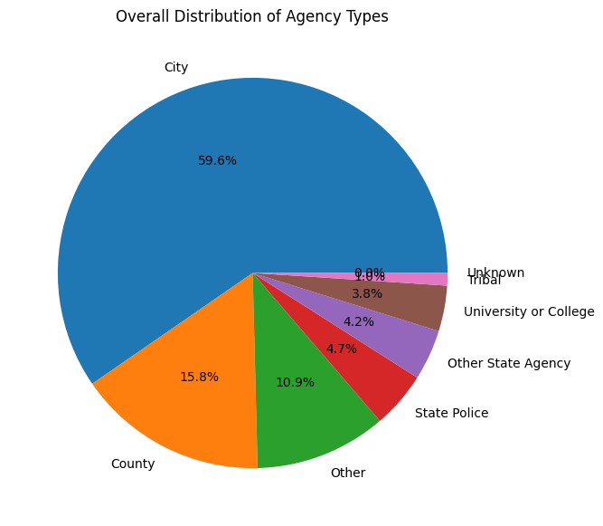
Overall Distribution of Agency Types
Insights:
City agencies form the largest portion nationwide
County agencies are the second most common
Other types (Tribal, State Police, University) make up smaller shares
Interpretation:
Most U.S. law enforcement is handled at the city level
County-level presence supports less urban or rural areas
“Other" reflects specialized or smaller-scale agencies

Slide 8
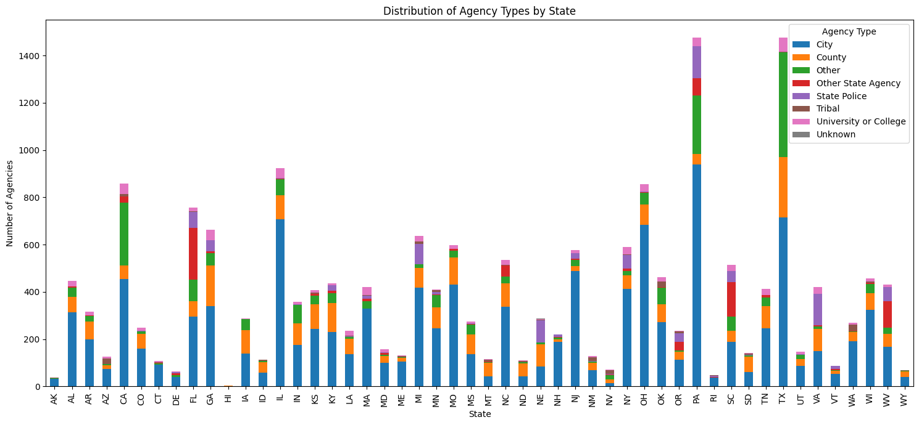
Distribution of agency types by state
City agencies dominate most states
States like TX, FL, CA, and IL have the highest total number of agencies
City agencies are more visible in urban states
County agencies are more visible in rural or less urbanized states

Slide 9
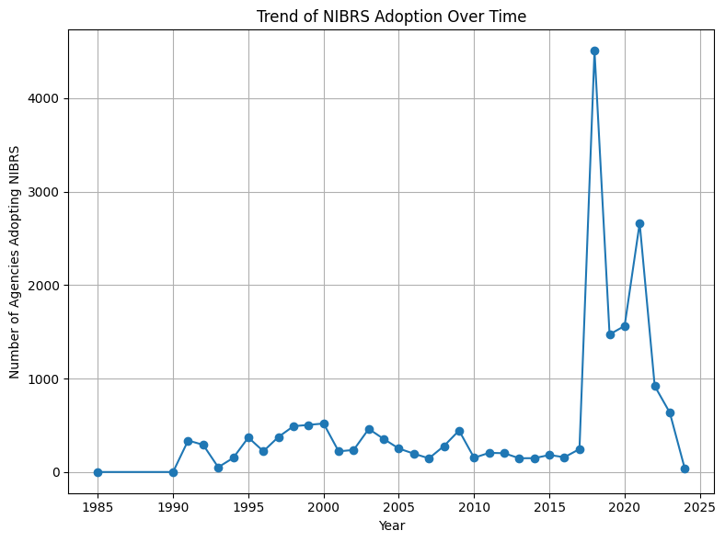
NIBRS Adoption Over Time
Insights:
Low adoption before 1995
Gradual increase after the year 1996
Sharp spikes around certain years
Adoption plateaued or slowed in recent years
Interpretation:
Reflects a nationwide shift toward better crime reporting
Spikes aligns with federal mandates and funding programs [2]

Slide 10
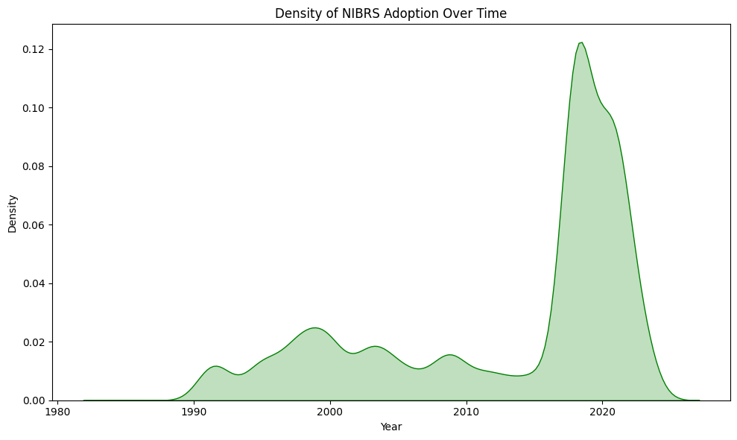
NIBRS Adoption Over Time

Slide 11
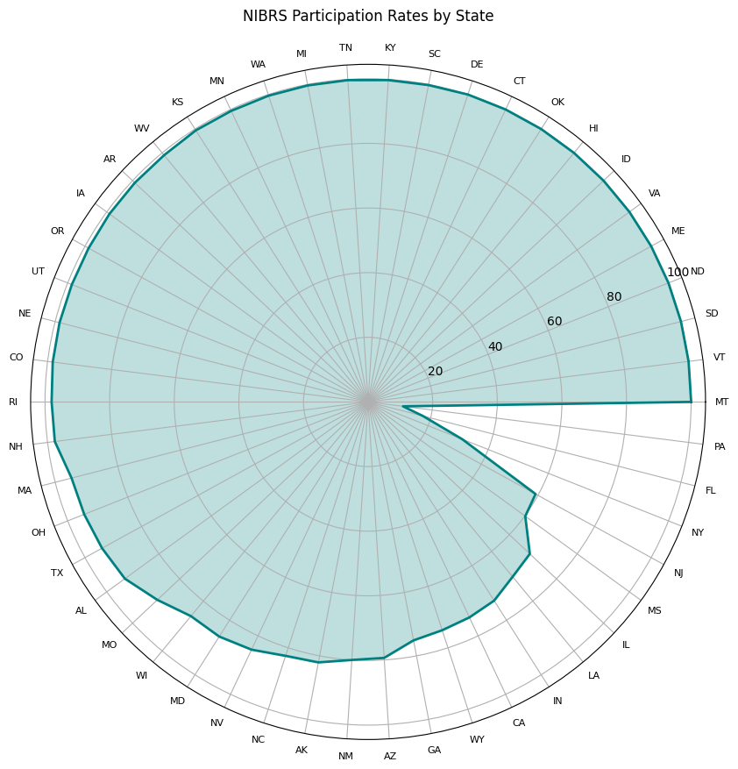
Statewise NIBRS Participation
Insights:
Most states show high participation (bars near outer edge)
Some states lag behind with noticeably shorter bars
Interpretation:
States vary in readiness and resources for NIBRS
High participation = strong commitment to detailed crime reporting
Low participation = potential barriers like budget, training, or tech limits

Slide 12
Results
City agencies are the most common across the U.S.
County agencies are more prevalent in rural states
NIBRS participation varies by state
Some states have full participation
Others show limited or delayed adoption
Trend over time: Gradual increase in NIBRS adoption with key spikes linked to policy changes

Slide 13
Conclusion
U.S. law enforcement structures differ significantly by region
Adoption of NIBRS is improving but still uneven
Insights can help policymakers identify gaps and target support
Standardized reporting like NIBRS is essential for accurate national crime data

Slide 14
References
[1] R-FOR-DATA-SCIENCE. (2025, February 18). Agencies from the FBI Crime Data API [Dataset]. GitHub. https://github.com/rfordatascience/tidytuesday/tree/main/data/2025/2025-02-18
[2] Federal Bureau of Investigation. (n.d.). National Use-of-Force Data Collection. FBI. Retrieved March 24, 2025, from https://www.fbi.gov/how-we-can-help-you/more-fbi-services-and-information/ucr/use-of-force

Slide 15
Thank You

